Slide 1
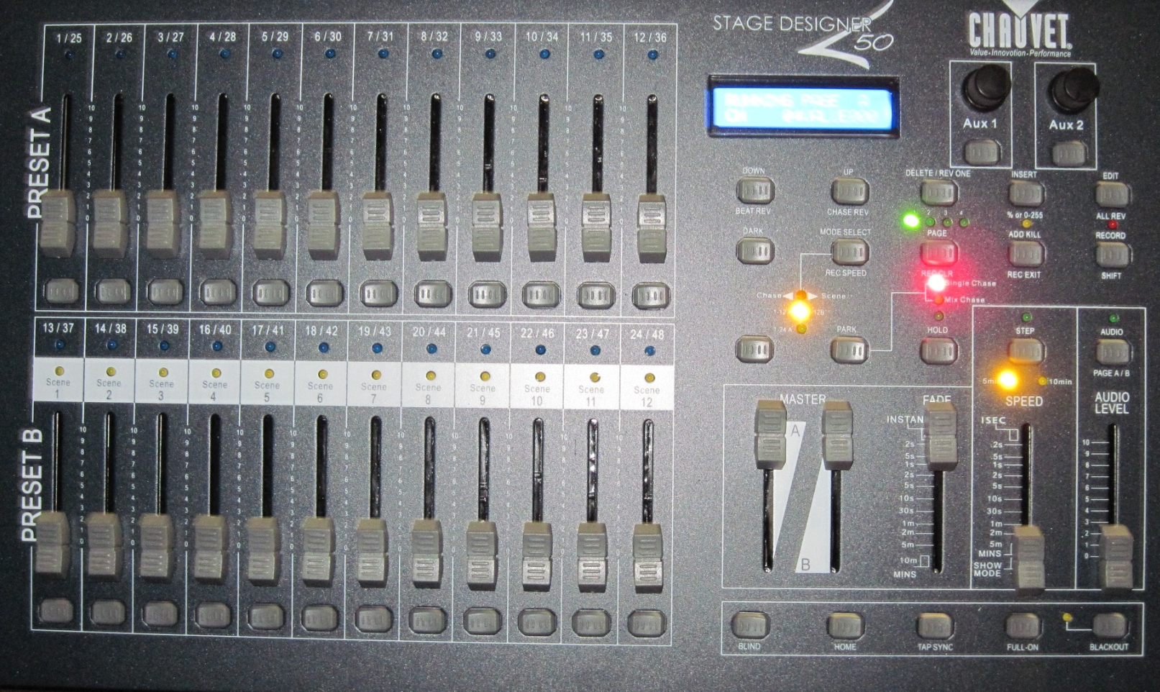
Chauvet 50 Basic Configuration
Middle LED (1->12A) should be on. If not, push MODE button until it is
Stage Right Pack (1-6)
Stage Left Pack (1-6)
IMPORTANT NOTE: board powers ON in “blackout” mode (this LED ON). Push button to clear.
Always put into blackout before powering down, or lights may remain on.
Full up
Full down
Controls Preset A (max up)
Controls Preset B (max down)

